Slide 1


What next after Google?
Dr Alexander Mikhalev
Monday 28 November 2023
The Oxford Praxis Forum
Notes:
To operate and make decisions in a modern complex world we need a new conceptual tools to deal with ever-increasing complexity of the information

Slide 2


The problem
The medical profession put a lot of effort into collaboration, starting with Latin as a common language and industry-wide thesauruses like UMLS.
On March 18, 2020, the American Journal of Biomedical Science & Research published paper claiming that eating a bat-like Pokémon sparked the spread of COVID-19
source
This Photo by Unknown Author is licensed under CC BY-SA
Notes:
Yet it full of scandals where publication in the prestigious journal would be retracted and the World Health Organisation would change its policy advice based on the article. It's not uncommon to see publication where randomness were presented as major findings. I think "paper claiming that eating a bat-like Pokémon sparked the spread of COVID-19" takes a prize. One would say that editors in those journals don't do their job, and while it may seem true, I would say they had no chance: with a number of publications about COVID (SARS-V) passing 300+ per day, we need better tools to navigate via such flow of information.

Slide 3
Will Vendor Help??
Galactica AI
Released on 15th of November 2022, after just a few days online — and tons of Twitter criticism — Meta-formerly-Facebook has taken down an AI it created that writes vaguely-plausible-sounding-but-ultimately-nonsensical academic papers. source

Slide 4

Journey
During lockdown:
Two data science competition on Kaggle – Cord19 Kaggle competition using NLP
Both my submissions failed
run out of memory
time and
storage on standard data science workbench
Participated in RedisConf hackathon 2020 (no award)
RedisConf 2021
TOP PRIZE WINNER (Platinum 10K USD)
in collaboration with Brian Wachanga (Kenia), https://klurdy.com
Notes:
From the start of lockdown using lack of commute (10 minutes) I decided to use the time more productively :
Participated in two data science competition on Kaggle – Cord19 Kaggle competition using NLP, in the beginning of lockdown joined competition to help medical professional to deal with rise of pulications – SARS-V publications went from 2 per month to 250 per day.
Both submissions failed
run out of memory
time and
storage on standard data science workbench
Waited for 1 week to populate Neo4J database from python structure which defined nodes and edges
Only to find out that fastest way is to create hash structures in Redis, dump via cli and load via neo4j-import
Participated in RedisConf hackathon 2020 – approximately 4th (non awarded place)
Started under assumptions I will be using RedisGraph and RedisAI
Watched Meir S talk on RGSync in Redis Gears
Wrote a whole pipeline in RedisGears
RedisConf 2021: Expanded project to use BERT QA and T5 Summary ML pipelines (and VR)
TOP PRIZE WINNER

Slide 5
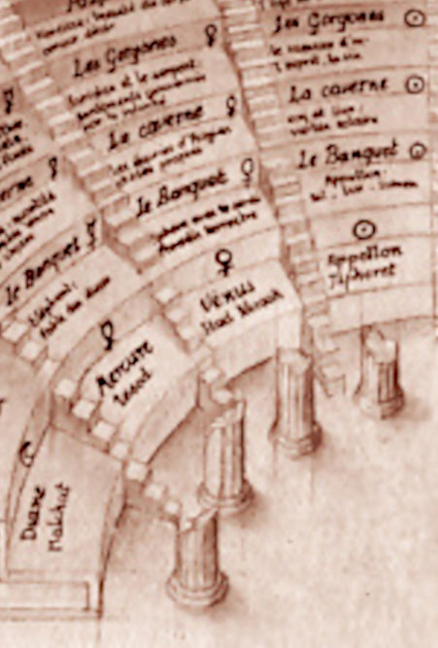
The Pattern
Open Source project for Natural Language Processing and Knowledge Graphs
Back to the roots of modern technology: taking inspiration from Douglas Engelbart work and demo “Augmenting human intelligence”:
With two core principles:
Language is at the core of our communication, we control language as part of leadership role or as part of architectural/engineering work: domain driven design or Business Objects Reference Ontology. But modern tools don't support re-use of the knowledge captured.
We regularly perform different roles: researcher, father, architect (analysts, surgeon and radiologist), each of them needs a different "viewmodel" - several type of interfaces "views", driven by the same knowledge base.

Slide 6
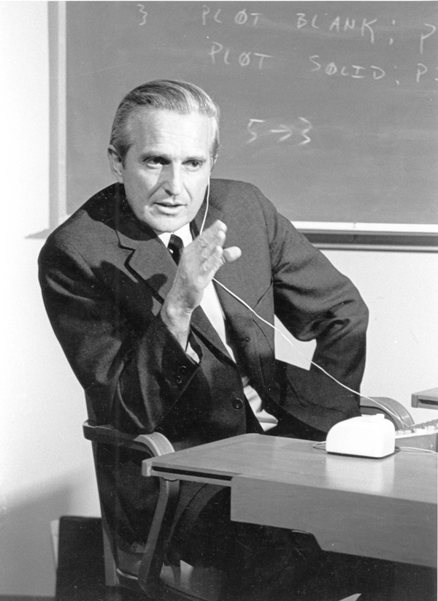
Mother of all Demos
"The Mother of All Demos" is a name retroactively applied to a landmark computer demonstration, given at the Association for Computing Machinery / Institute of Electrical and Electronics Engineers (ACM/IEEE)—Computer Society's Fall Joint Computer Conference in San Francisco, by Douglas Engelbart, on December 9, 1968

Slide 7
D. Engelbart ”Augmenting Human Intellect: A Conceptual Framework”
“By "augmenting human intellect" we mean increasing the capability of a man to approach a complex problem situation, to gain comprehension to suit his particular needs, and to derive solutions to problems… whether the problem situation exists for twenty minutes or twenty years. We do not speak of isolated clever tricks that help in particular situations. We refer to a way of life in an integrated domain where hunches, cut-and-try, intangibles, and the human "feel for a situation" usefully co-exist with powerful concepts, streamlined terminology and notation, sophisticated methods, and high-powered electronic aids.

Slide 8
Foundation of the today interactions between humans and computers are rooted in Engelbart demo
Personal Computer
Mouse and GUI
Engelbard’s Demo
Virtual and Augmented Reality
2022
1980
1973
1968

Slide 9

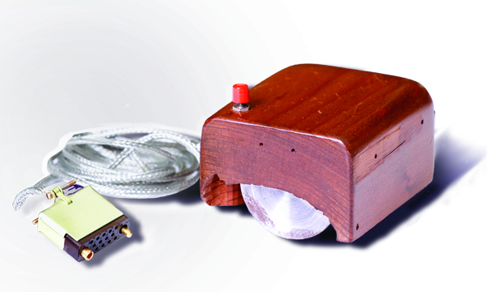
Augmenting Human Intelligence using modern AI and VR tools
Demonstrating new concepts to assist knowledge
The first prototype of a computer mouse,
as designed by Bill English from
Douglas Engelbart's sketches^{[1]}
Notes:
Why interface is always flat and requires mouse and keyboard?

Slide 10
Search or information exploration shall be visual, avoid confirmation bias.
Natural Language Processing Pipeline (NLP)
System 1 AI (fast, intuitive reasoning)
System 2 (high-level reasoning)
Present output in VR/AR
Vision
Notes:
When I am exploring topics on science or engineering, I look at the diversity of the opinion, not the variety of the same cluster of words, same thought. I want to avoid confirmation bias. I want to find articles relevant to the same concept, not necessarily the ones which have similar words. My focus is to build a natural language processing pipeline, capable of handling a large number of documents and concepts, incorporating System 1 AI (fast, intuitive reasoning) and System 2 (high-level reasoning) and then present knowledge in a modern VR/AR visualisation. Search or rather information exploration should be spatial preferably in VR (memory palace, see Theatre of Giulio Camillo). A force-directed graph is a path towards it, where visuals are assisted by text — relevant text pops up on the connection and where people explore the concepts and then dig deeper into text. The purpose of the pipeline that knowledge should be re-usable and shareable.

Slide 11

Knowledge Graph: the unspoken ingredient behind every intelligent system
“It’s about things not strings”
Not only about data, but
entities with their properties
relationships between them
hierarchies of classes, categories and types
Notes:
Key characteristics of knowledge graphs:
A knowledge graph needs to be connected around relevant attributes. Since not all data is knowledge, we’re looking for pertinent information that’s contextually related.
A knowledge graph is dynamic in that the graph itself understands what connects entities, eliminating the need to program every new piece of information manually. A knowledge graph is able to make appropriate associations across attributes that are important to us because we’ve already programmed them in.
A knowledge graph needs to be understandable. Sometimes we say it’s semantic because the knowledge itself tells us what it is. The intelligent metadata helps us traverse the graph to find answers to specific problems, even when we don’t know exactly how to ask for it. In practice, a knowledge graph usually contains heterogeneous data types.
It combines and uncovers connections across silos of information.

Slide 12
Where are they?
These systems are used everywhere from military-industrial complex to our everyday lives.
Palantir, Primer, and others enable massive intelligence and counter-intelligence projects in military and security forces,
Quid and RecordedFuture enable competitive analytics, Bottlenose and others enable online reputation analytics,
Microsoft Graph enables new kinds of productivity apps for the enterprises, Google Knowledge Graph and Microsoft’s Satori enable everyday search queries, and together with Amazon Information Graph they power corresponding AI assistants by enabling them to answer questions about the world facts.
All these (and many other more specialized) systems are used in different domains, but all of them use Knowledge Graphs as their foundation.

Slide 13
What is the UMLS?
The UMLS, or Unified Medical Language System, is a set of files and software that brings together many health and biomedical vocabularies and standards to enable interoperability between computer systems.
Unified Medical Language System (UMLS)
The UMLS integrates and distributes key terminology, classification and coding standards, and associated resources to promote creation of more effective and interoperable biomedical information systems and services, including electronic health records.
The Three UMLS Knowledge Sources
Metathesaurus: Terms and codes from many vocabularies, including CPT, ICD-10-CM, LOINC, MeSH, RxNorm, and SNOMED CT. Hierarchies, definitions, and other relationships and attributes.
What is the UMLS? Broad categories (semantic types) and their relationships (semantic relations).
What is the UMLS? Lexicon and Lexical Tools: A large syntactic lexicon of biomedical and general English and tools for normalizing strings, generating lexical variants, and creating indexes.
UMLS in Use
You can use the UMLS to:
Link terms and codes between your doctor, your pharmacy, and your insurance company
Coordinate patient care among several departments within a hospital
Process texts to extract concepts, relationships, or knowledge
Facilitate mapping between terminologies
Develop an information retrieval system
Extract specific terminologies from the Metathesaurus
Create and maintain a local terminology
Develop a terminology service
Research terminologies or ontologies

Slide 14
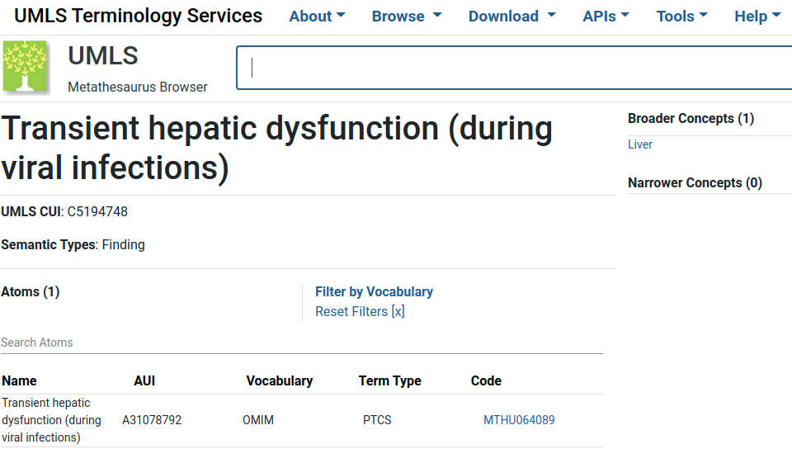
Unified Medical Language System (UMLS)

Slide 15
General principle to build knowledge graph
Related
Concept
Concept
Related sentence
Concept CUI
Concept CUI
The rate of transmission to an infant born to
Title: AFEBRILE PNEUMONIA IN INFANTS
C5190195:
transmission
C5195638:
birth

Slide 16
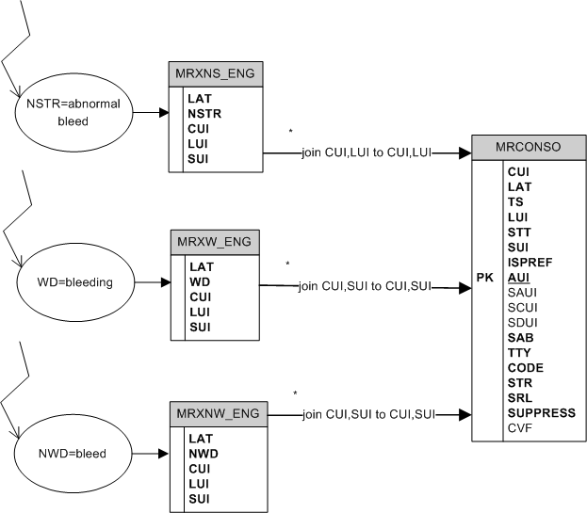
UMLS Database Query Diagrams
How to perform searches for normalized strings, normalized words, or regular words

Slide 17
But term “bleeding” matches to 11000 concepts (CUI)!
Proposed Solution: Select role and create subset knowledge graphs per ROLE
UMLS subset relevant to GP or Nurse
- anst|T017|Anatomical Structure
- dsyn|T047|Disease or Syndrome
- bpoc|T023|Body Part, Organ, or Organ Component
- diap|T060|Diagnostic Procedure
Notes:
Highligh importants of roles mapping to language, all modern search engines treat you as average person over all of your roles

Slide 18
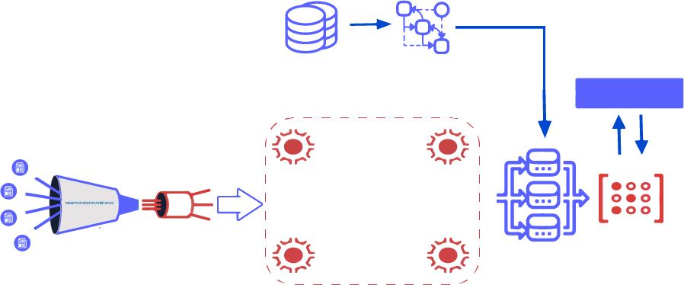
Solution Overview: NLP pipeline
Read UMLS table
Build automata
Flask API
Extract & parse cord-19 documents
Create streams
Language
detector
Spell
checker
Split
paragraphs
Redis Graph
Redis Gears
Matcher
Notes:
Why do you need RedisGears based pipeline? While 50 thousands articles is a small dataset by modern standard, it’s more than single laptop can handle. Redis Gears provides a very easy way to create a distributed data processing. We will be re-using half of the pipeline - until matcher step, but then we fork and adjust pipeline to use Redis AI

Slide 19
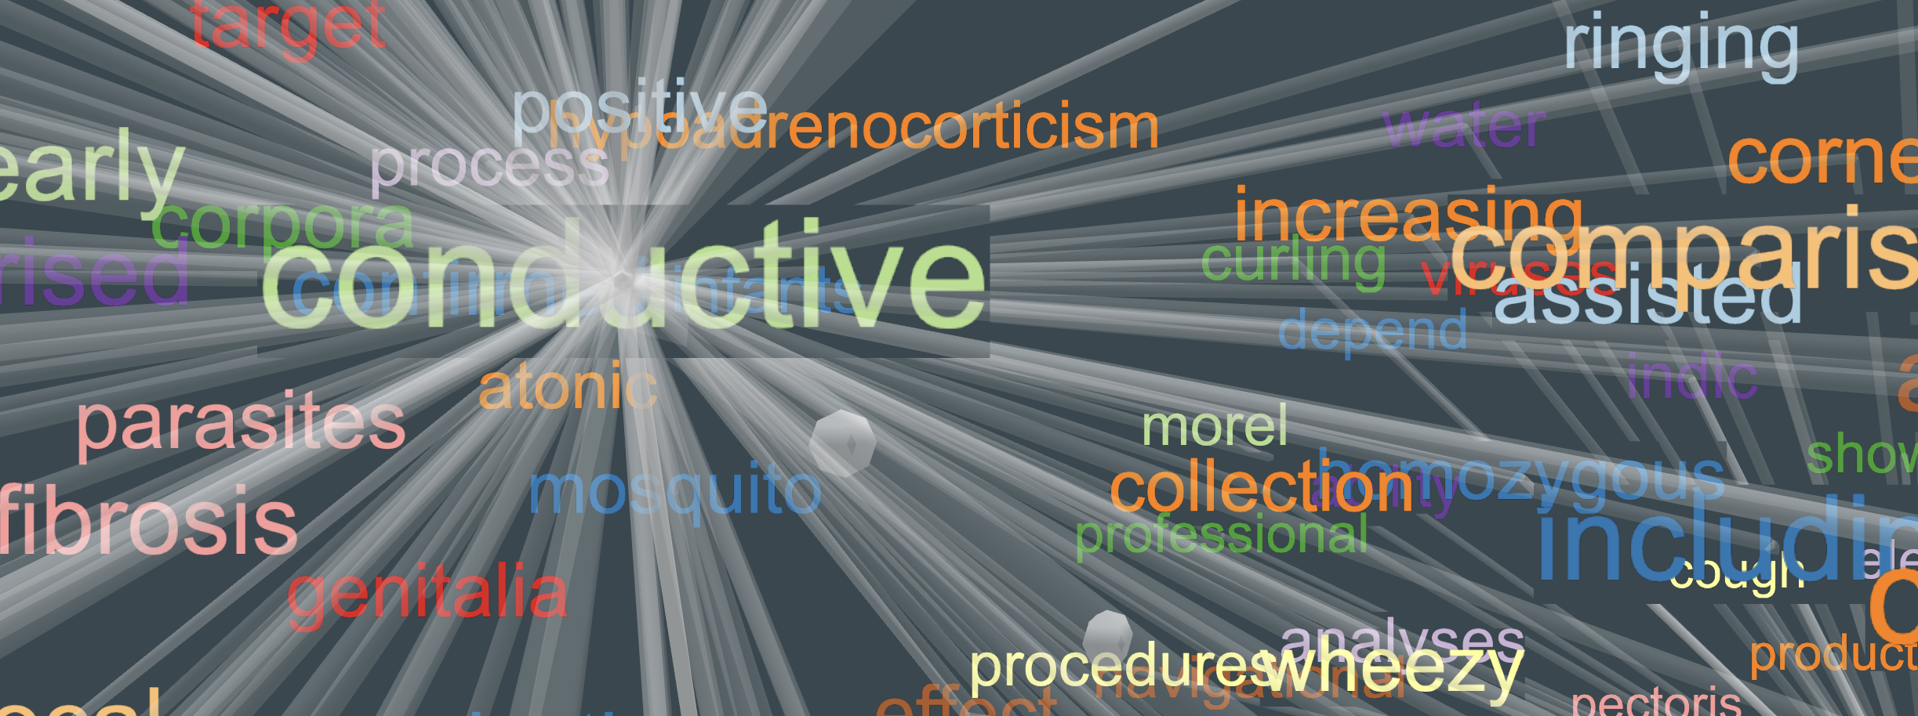
Demo
https://thepattern.digital/
Mozilla Firefox Only

Slide 20


Other medical roles may need different interfaces
Notes:
Question/Answering

Slide 21
Solution Overview
Pre-Process articles using
Pre-load models for QA Run inference in Memory
I would like to incorporate modern machine learning models into NLP pipeline for Question Answering (like chatbot)
Creating a BERT based Question Answering services is quite straightforward, except even on such “small” dataset as cord19, API response time will 10-15 seconds which isn’t good users experience.
This is where Redis and Redis Modules come into picture.
Notes:
vision which I have been thinking about for a while: work with information should not be limited to 2D and we are looking for “things not strings”. Using Redis technologies whenever possible.

Slide 22
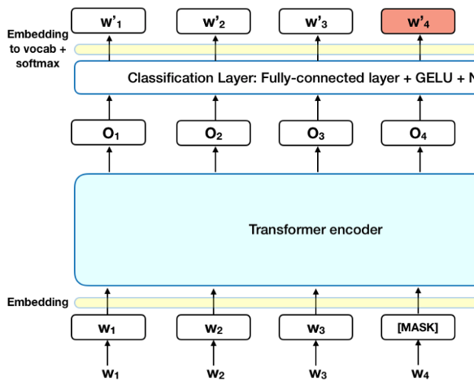
BERT models introduction
BERT (Bidirectional Encoder Representations from Transformers)
Created by researchers at Google AI Language
State-of-the-art results in a wide variety of NLP tasks, including Question Answering (SQuAD v1.1), Natural Language Inference (MNLI),
Next Sentence Prediction, text classification and many more.
Read more about BERT at Towards Data Science blog

Slide 23
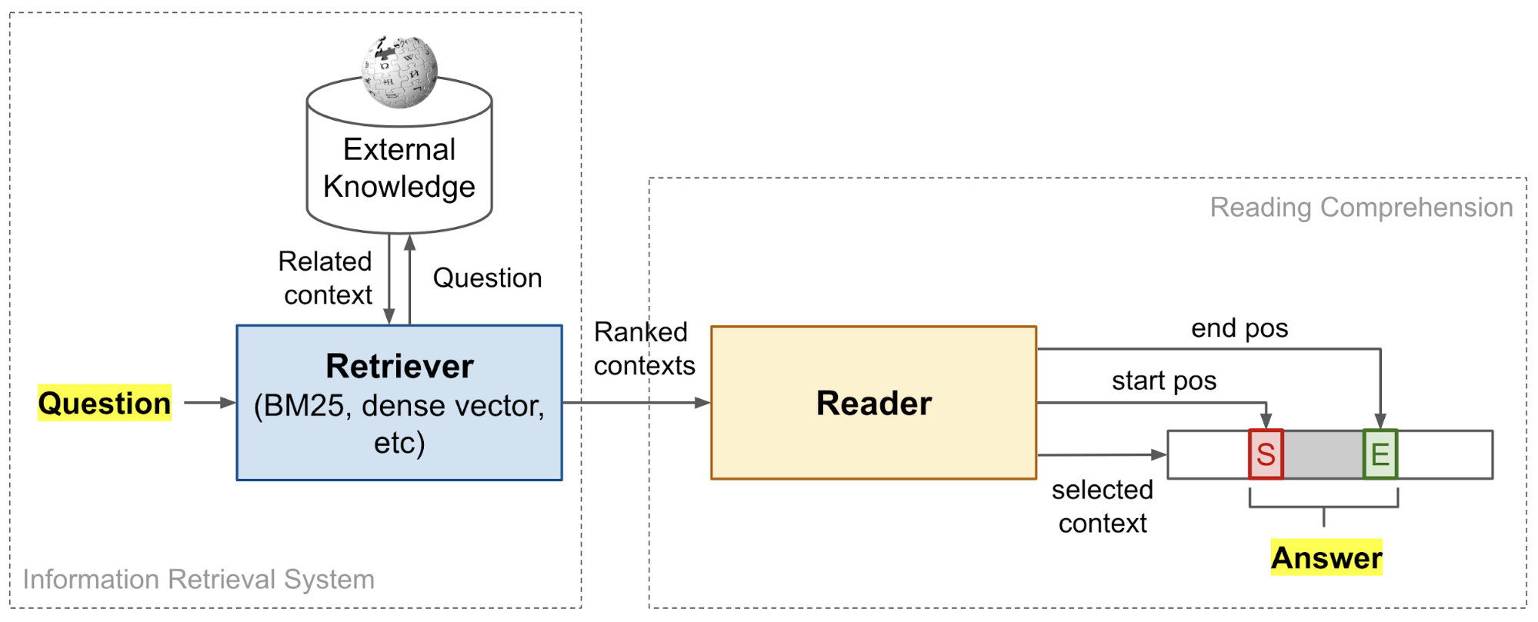
Open Domain Question Answering
Find out more about Open Domain Question/Answering

Slide 24
Medical domain Question Answering
Q
How does temperature and humidity affect the transmission of 2019-nCoV?
Recently new members of the Astroviridae family have been associated with neurologic disorders in humans and several reports have suggested the possibility of a cross species transmission that could eventually become a zoonotic problem 2 3
Candidate Paragraph
A
several reports have suggested the possibility of a cross species transmission that could eventually become a zoonotic problem

Slide 25

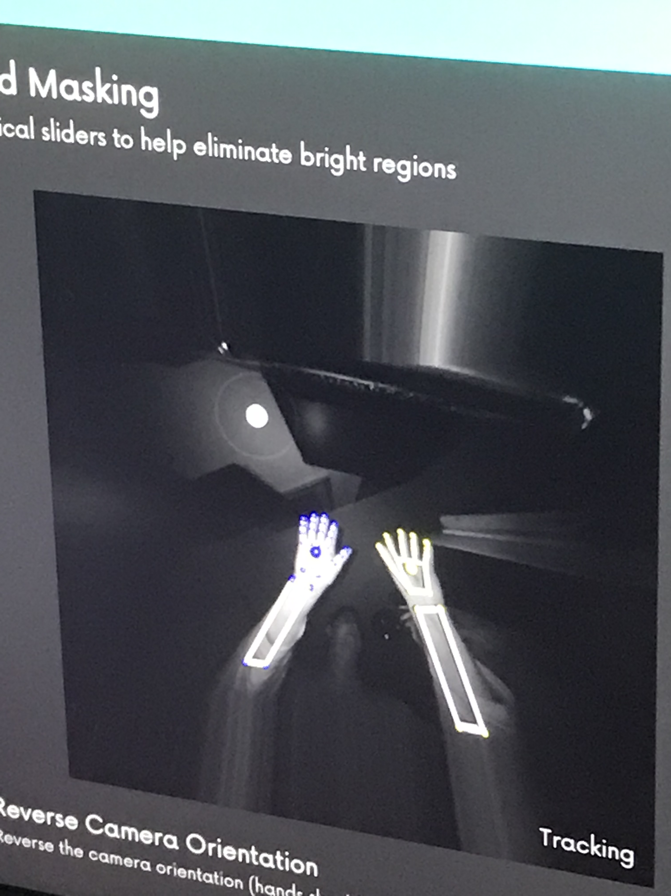
Demo 2
https://thepattern.digital/

Slide 26
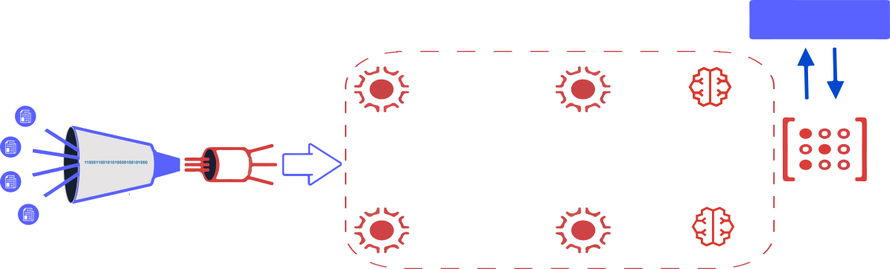
API for Extractive Question Answering using BERT model running inside Redis AI
Flask API
Extract & parse cord-19 documents
Language
detector
Spell
checker
Split
paragraphs
RedisAI
RedisGears
RedisAI

Slide 27

Next Steps
NLP is of the utmost importance in the modern world
Let’s build and open source tools to help different communities manage their knowledge
If you want to read your papers in oculus quest – let’s work on making it happened
Notes:
Recreate summary slide: Conclusion:
As with any scientific endeavour some things succeeded and some don’t:
Novel type of graph based embeddings for modern AI/ML. Simple and efficient
State of the art deployment of BERT QA models
VR based visualisation
Didn’t work: sensors and joined UX

Slide 28
Resources
The Pattern - Advanced Machine Learning NLP pipeline (3 pipelines inside) to help medical community to work with large amounts of unstructured information. Full code on GitHub
Reference Architecture for AI - open-source community platform to discuss how to deploy Machine Learning products into production with trade offs and performance benchmarks
Terraphim AI Privacy First AI assistant (learnings from The Pattern for personal use)
Metacortex Engineering Engineering practices for AI and human ethical collaboration and alignment
Join our team on Discord
Email: alex@applied-knowledge.systems

Slide 29
References
Measuring Discourse Bias Using Text Network Analysis
Open Domain Question/Answering
The Knowledge Graph Cookbook
Entity Co-occurrence graphs as Mind Maps
The Pattern project

